Slide 1
Introduction to D3.js
Hands-on learning and plenty of resources.

Slide 2
This Repo:
https://github.com/nuitrcs/Intro_to_d3_workshop

Slide 3
What is D3 capable of?
https://ligo.northwestern.edu/media/mass-plot/index.html
http://www.r2d3.us/visual-intro-to-machine-learning-part-1/
http://bit.ly/2wJEeIy
http://nbremer.github.io/urbanization/
https://www.nytimes.com/interactive/2014/upshot/buy-rent-calculator.htmlhttps://bost.ocks.org/mike/algorithms/

Slide 4
y tho?
answer: the web + data = magic.

Slide 5
But why is it so hard?
Why not just something like chart_library.call(bargraph)?
These solutions exist and you should use them when appropriate:
plotly
ggplot2
matplotlib

Slide 6
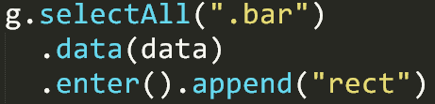
Two very important things:
Binding data to the DOM
Low-level geometric expressiveness

Slide 7
Think of making a cake
How do most people do it? Is store-bought even good though?

Slide 8
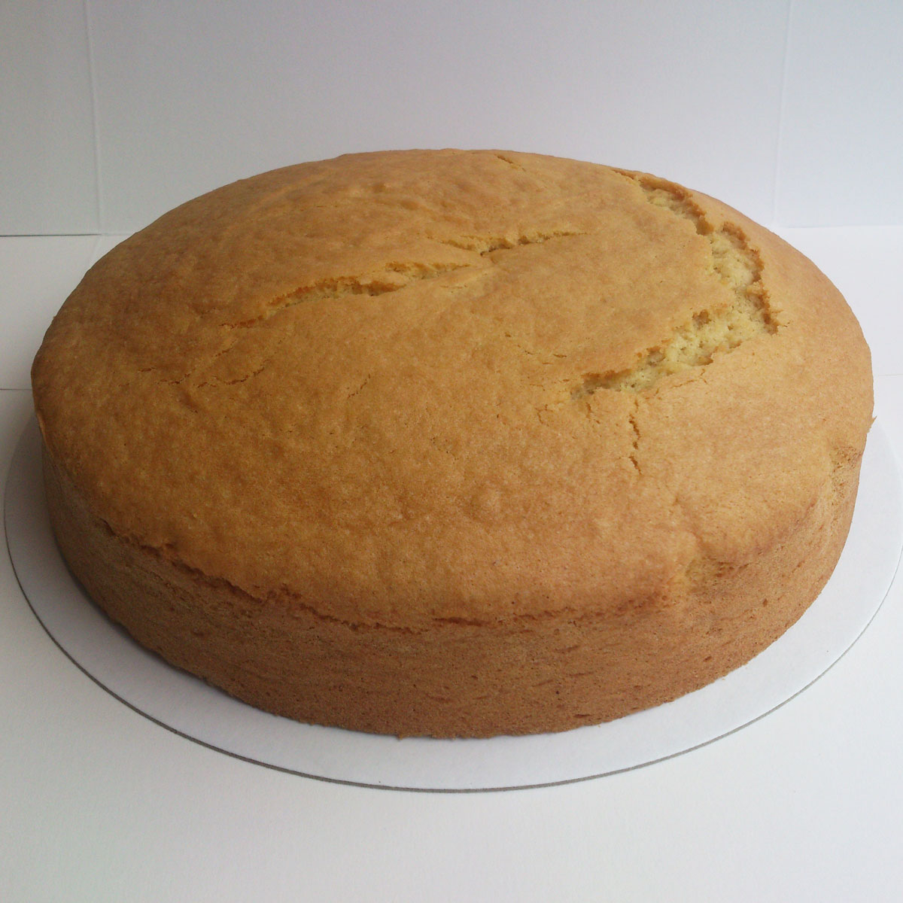
Microsoft Excel

Slide 9

Plotly, ggplot2, Matplotlib

Slide 10
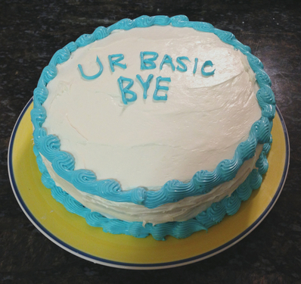
Tableau

Slide 11

D3 is tiramisu

Slide 12

Or whatever cake you want

Slide 13
The difference is in the recipe:
“Store bought” cake is easy:
eggs, water, and their pre-mixed flour,
bake,
and then if you have the time: add frosting
In the end? Boring!
Cake “from scratch” is hard:
You have to think about each ingredient, its quality, its needs
You must imagine your end-result to find a useful recipe to get there
It can take a long time to master each ingredient
In the end? A unique masterpiece!

Slide 14
Cake from Scratch
A “grammar of graphics” is key:
How do we talk about and use visualizations?

Slide 15
Getting Started:
Get a text editor: Sublime, Atom, Notepad++, or Brackets
Make sure you have either Chrome or Firefox
Open the “barchart_ready.html” file in your browser
Open the “barchart_ready.html” file in your text editor

Slide 16
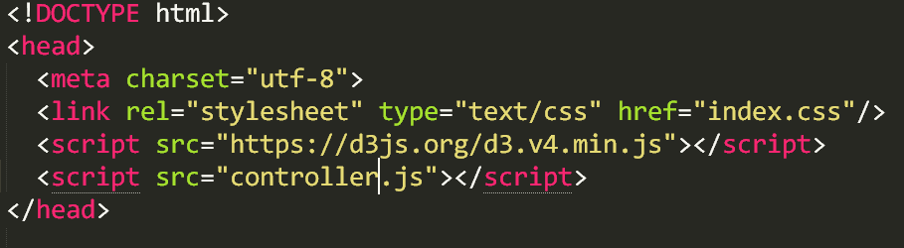
Build your environment:
Build index.html file with d3 source link (local or web)
Create empty “index.css” file
Create empty “controller.js” file

Slide 17
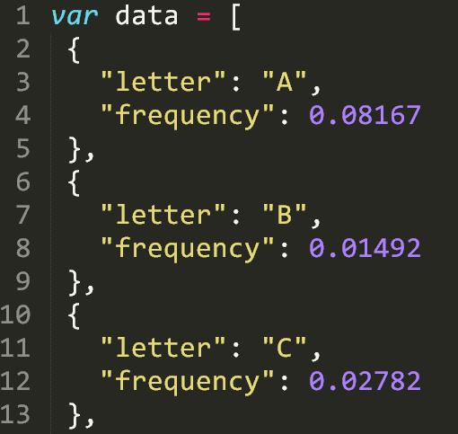
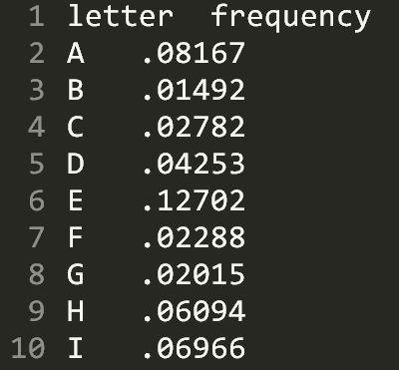
Look at our data, literally:
Open both data.tsv and data.js in your text editor

Slide 18
Look at the data.tsv loading:
Show TSV import, using d3
(Show Firefox vs Chrome here)
(Note about local webserver)

Slide 19
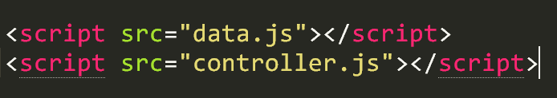
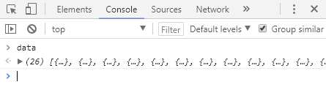
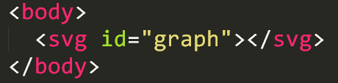
Look at the data, in our environment:
Import data.js into your html
Console log the data
Create an <svg> element with id=“graph” inside <body>

Slide 20
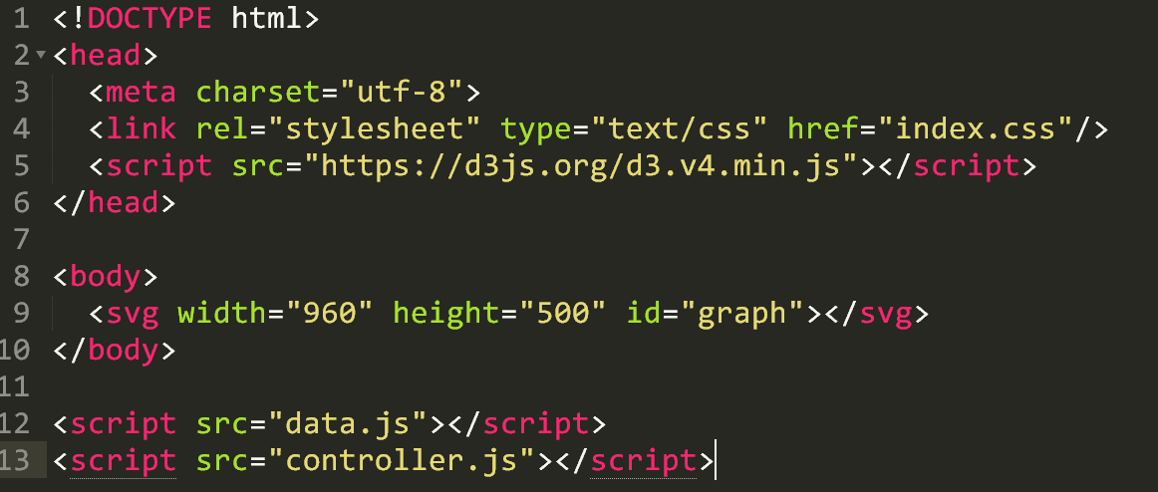
Review HTML layout

Slide 21
Begin writing code!
Let’s recreate this monster (follow along)

Slide 22
1a. Beginning with D3
Once we get set up, we should only visit controller (and css)
Select the “#graph” element
Reference this with a var
Give it dimensions
Append g
Reference this g with a var
g.selectAll(‘.bar’)
.data(data)
.enter().append(‘rect’)
Discuss SVG types & explain SVG

Slide 23
1b. Use the bound data!
Make height = d.frequency
Make width = 10
Make x = i*10
Try:
Make height = 1000x the frequency
Make width = 20
Make x = i*22

Slide 24
1c. How to inspect
Show __data__ property of the element
Show console.log(this)
(i)
(d)
d3.select(this)

Slide 25
2. Build a scale that makes sense
Create margin object
Create “actual” width/height variables, subtracting the margins
Pass these to x range - band (width) and y range - linear (height)
Pass our data to the domain, using map for letters and max for requency
Update our attr binding to use these new things

Slide 26
3. Add the axes and some styling
Append g with an axisBottom on x, translate for height (to put on bottom – otherwise it is a downward axis on the top)
Append g with an axis for y, add 10 ticks with %
Open our empty index.css
Add fill color for .bar class and .bar:hover
Remove axis--x path

Slide 27
Resources
Things you should explore when looking further

Slide 28
Read the docs!
D3: https://github.com/d3/d3/wiki
Web: https://developer.mozilla.org/en-US/

Slide 29
Top 3 resources:
The d3 API documentation
MDN web standards documentation
Googling things you want to make (“d3 scatterplot bl.ocks”)

Slide 30
Listing the Basics:
Know what these are, you will use them often:
Selections (select, selectAll and how they work)
SVG types (circle, rect, text, path)
Data Enter/Append
Data Exit/Remove
Chaining
Attributes+Transitions
Arrays: Min/Max/Range, Keys, Merge, Nest
Scales
Color
Axes

Slide 31
Design Basics for Charts
http://bit.ly/1RfYZxm
Worth mentioning: There are additional slidedecks by the above authors on Maps, Pie Charts, and even Data Tables

Slide 32
Advanced d3 Abilities
Curve Interpolations: http://bit.ly/2xR9VxX
Voronoi: http://bit.ly/2gK35mi
https://bl.ocks.org/mbostock/4060366
Zooming: http://bit.ly/2f6WYsg
Brushing/Zooming: http://bit.ly/2lTjfef
Stacking: http://bl.ocks.org/mbostock/582915
Collision Constraint: http://bit.ly/2vOPk05
Dragging: http://bit.ly/2j6x5gH
“Each”: https://bl.ocks.org/mbostock/9490313
Dispatching (super advanced): https://bl.ocks.org/mbostock/5872848
Modules/Plugins (most advanced):
https://bost.ocks.org/mike/d3-plugin/

Slide 33
SVG Documentation
https://mzl.la/1nP24aN
Check it: this is good to be familiar with, as is all of MDN

Slide 34
SVG Level 2
http://bit.ly/2xdgJsI
Plug: VisualCinnamon is extraordinary. Their work on SVG in particular is the best I have found to date.

Slide 35
Maps in D3
http://bit.ly/2f7o4Q5
http://oreil.ly/1UnNtFe
Warning: This is advanced level!
Also: The d3 library contains geo maps of many kinds already.

Slide 36
D3’s Extensive Library:
https://github.com/d3/d3/blob/master/API.md
Statistics, histograms (4 kinds), ES6’s Map/Set, Nesting, Data Ingestion (CSV, TSV, etc), many animation/easing/time options, force/physics, geography and projections, spherical maps/math, and that is just the first 25% of it:

Slide 37
Canvas and D3
http://bit.ly/2xRh9Ci
Important: Canvas is a native web technology, similar to SVG. You can google the comparisons, but it is a good option if you need serious performance over visual quality.

Slide 38
Data Processing in JS
http://learnjsdata.com/index.html
Note: optional resource. This is very nice to have handy.

